Slide 1
Considering Fisheries Impacts During Allocation of OWF leases
Duc Le : lephuo@oregonstate.edu
Steve Swartz: SwartzSt@oregonstate.edu
Oregon State University, Environmental Sciences

Slide 2
Issue
Most existing leasing processes focus on energy generation (power output). We need a holistic approach that accounts for social, economic, and environmental factors, too.
How can we support the consideration of issues other than power generation during offshore wind farm (OWF) lease allocation?

Slide 3
Problem
OWFs have significant tradeoffs with other vital coastal resources:
Fisheries
Wildlife
Tourism and Views

Slide 4
So What?
Electricity: renewable energy is critical .
Fish: vital for coastal communities.
Tourism: coastal communities depend on tourism.
Biodiversity: essential for biodiversity and long-term ecosystem services.
Inclusivity: political need for the process to capture local as well as corporate concerns

Slide 5
Literature
Crow White et al. (2024)
Tradeoff analysis: wind energy, fisheries and wildlife.
Framework applied to Oregon.
Perry & Heyman (2020) & Stelzenmuller et al. (2021)
Co-location of fisheries & wind farms.
Marina & Samantha (2023)
Economic impacts: Fuel, revenue, insurance, support businesses
Wang et al. (2022) & Blake et al. (2025)
Spatial data methods for fisheries value mapping
Notes:
1.Crow White et al. (2024)
What they did: Developed a tradeoff analysis framework for evaluating wind farm impacts on fisheries and wildlife. It integrates spatial data layers for wind energy, fisheries, and wildlife to find optimal wind farm locations that minimize negative impacts.
What we learn: This framework is the core method we will use to model Oregon’s wind farm siting, balancing energy production and environmental preservation.
2. Perry & Heyman (2020) & Stelzenmuller et al. (2021)
What they did: Both papers explore the impacts of OWFs on fisheries and co-location opportunities. Perry & Heyman (2020) focus on artificial reef benefits from wind farms, while Stelzenmuller et al. (2021) examine passive fishing (crab pots) and spatial management.
What we learn: These papers emphasize the potential benefits of co-locating fisheries with wind farms (especially crab pots) and suggest methods for spatial conflict analysis—critical for our co-location analysis in Oregon.
3. Wang et al. (2022) & Blake et al. (2025)
What they did: Both focus on spatial analysis of fisheries and wind farm overlap. Wang et al. (2022) map fisheries and potential wind farm sites in California, while Blake et al. (2025) provide economic mapping of LCOE and fisheries revenue for the U.S. West Coast.
What we learn: These studies provide useful spatial data methods for fisheries value mapping and wind energy costs. They will guide our economic analysis and help prioritize high-value fisheries in Oregon when planning wind farm sites.
In the literature, we draw from several key studies:
Crow White et al. (2024) gives us the tradeoff analysis framework for balancing wind farm development with fisheries and wildlife conservation goals. This framework will be our primary method for spatially modeling Oregon’s wind farm siting.
Perry & Heyman (2020) and Stelzenmuller et al. (2021) focus on the synergies and tradeoffs between wind farms and fisheries, particularly around passive fishing methods like crab pots. This is useful for analyzing co-location opportunities for Oregon's fisheries.
Wang et al. (2022) and Blake et al. (2025) both use spatial mapping techniques for assessing fisheries overlap with OWFs. These methods will guide our economic analysis, helping us understand the impacts of wind farm siting on Oregon’s fisheries value.

Slide 6
Strategy
Wind Datasource
Wrangling
Notebook
Assess
Results
Fisheries Datasource
Wrangling

Slide 7
Data
Wind: NREL WIND Toolkit 2019 (120m height)
~13.9M records
Data aggregated to a 2km x 2km grid
Power analysis using typical10MW power curve
Assume $50/MWh
Fisheries: Oregon commercial fishing economics
Allocate projected revenue to data grid

Slide 8
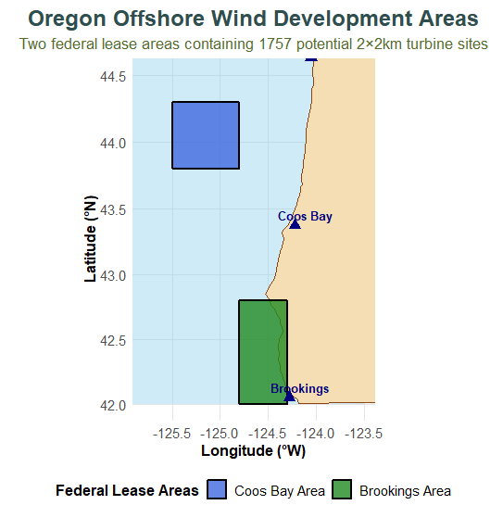
Analysis: Grid
Create Oregon offshore lease areas
Load maps package for coastline
Define Coos Bay rectangle boundary
Define Brookings rectangle boundary
Generate systematic two-kilometer turbine grid
Notes
1757 potential turbine sites
4km² spacing

Slide 9
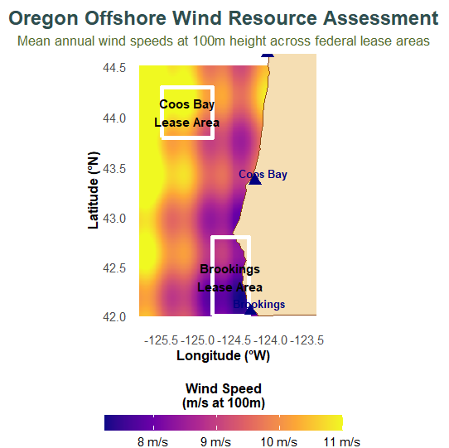
Analysis: Wind Data
Generate high-resolution offshore coordinate grid
Calculate distance from Oregon coastline
Higher speeds offshore and north
Apply realistic wind speed equations to reduce data to this view
Create smooth heat map bitmap
Notes
Power availability and wind speed are “the same” at this abstraction
$2.5B total annual revenue potential at $50/MWh

Slide 10
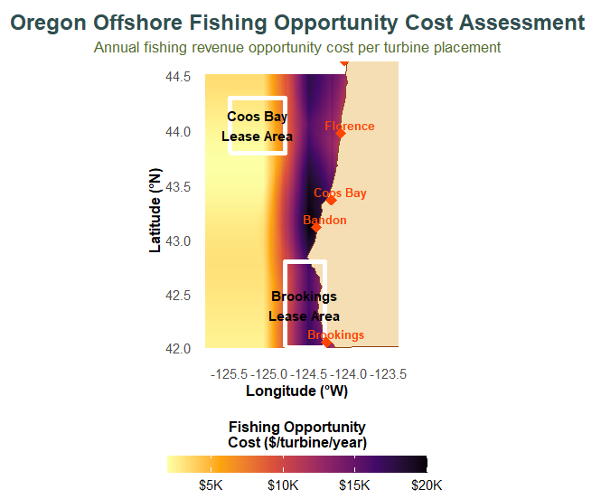
Analysis: Fisheries Data
Base: $190m fisheries revenue per year
Shore proximity effect (40%)
Distance from shoreline
Exponential $ decrease from offshore
Harbor proximity effect (30%)
Weighted distance to nearest harbor
Scaled by harbor importance
Depth suitability effect (20%)
Est: 50m + 180m per degree longitude
100-300m depth receives full weight
Shallow and deep areas get less
Species Distribution Effect (10%)
Simple model of species distribution

Slide 11
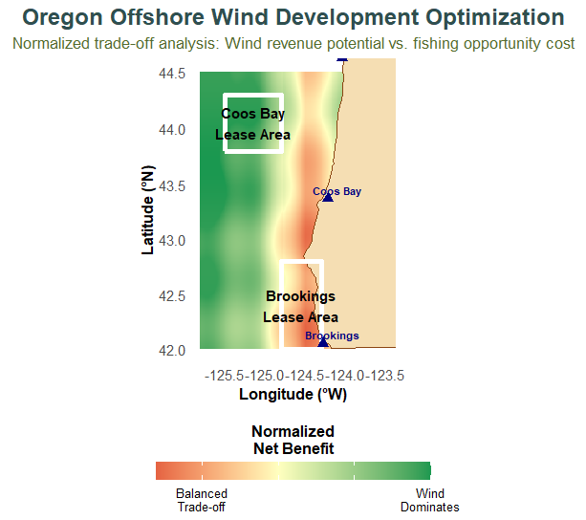
Method: Cost/Benefit Comparison
Calculate wind revenue per turbine
Calculate fishing opportunity cost values
Normalize both to zero-one scale
Subtract fishing cost from wind
Positive values indicate optimal sites
Notes
Green shows wind revenue dominates
Red shows fishing costs dominate
Yellow shows balanced trade-off zones

Slide 12
Results
The $2.5 billion potential revenue of electricity generation dwarves the $9million potential revenue loss of fisheries revenue, ignoring the fact that people can fish elsewhere and wind turbines don’t totally destroy revenue
But….
Brookings sites, close to shore, have a potentially higher fisheries impact
Coos Bay sites, far from shore, have more wind and less fisheries impact

Slide 13
Solution 1: Avoid harmful sites
Prioritize sites that are farther from shore
Fortunately, this is the same as prioritizing sites with more wind

Slide 14
Solution 2: Economic Transfers
Given the relative sizes of costs and benefits, we could consider transfers from electricity companies to fisheries to pay for the loss in fishing opportunities
This money could go to fishing cooperatives, fishing NGOs, or to fishing concerns

Slide 15
Benefits of this methodology
Simple discussable way to test assumptions, alternatives
Analysis can be updated as assumptions are tested, or data is available
Often analysis will identify nearly cost-free changes
More factors can be added so long as their costs can be normalized to dollars
Includes players other than power companies
Safeguards coastal communities, economic interests, etc

Slide 16
Next Steps
Better fishing data
More factors
Integrate with state’s leasing process

Slide 17
Thanks
James and Zech, for helping seed our bibliographic research
Classmates for useful feedback

Slide 18

Considering Fisheries Impacts During Allocation of OWF leases
Duc Le : lephuo@oregonstate.edu
Steve Swartz: SwartzSt@oregonstate.edu
Oregon State University, Environmental Sciences

